Slide 1
Assignment 5
Kochetygova Maria

Slide 2
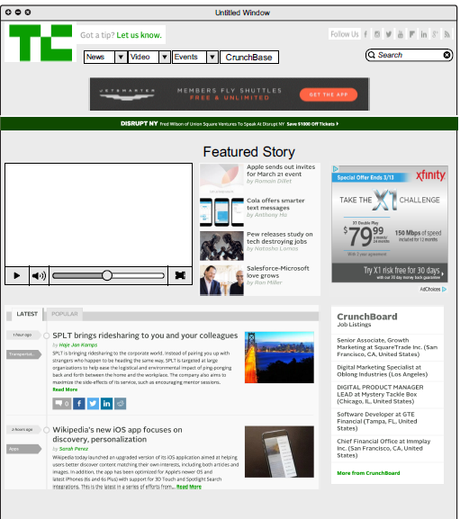
TechCruch

Slide 3
Overview
1) It is understandable from the first second.
2) It is easy to navigate and find information
3) Information is organized consistently ( chronological order)
For people who check the website several times a day
4) There is a clear sense that designer know who are their users because the website is broken on different categories. For all different users, it is easy to find the information they need. For example, people who are looking for events know right away where to click on. People who are interested in the news can pick latest news or search it by category.
5)The designer also thought that people who would visit their website would have something to do with IT and Technology, so they decided to post ads for companies who might look for new employees.

Slide 4
Overview
6) Information Architecture is hierarchical approach from top-bottom
7) The website provides info about team and who are working at TechCrunch which makes the website trustworthy
8) The website satisfy web user need from the first age because as I said before TechCruch has a clear sense of their users
According to Chapter 7 and Color pallets
The color is the great way to communicate with users and create a brand awareness. TechChrunch has a label that is a green color. On their website they use different shades of green that helps customer to read through the website and memorize the company brand.

Slide 5
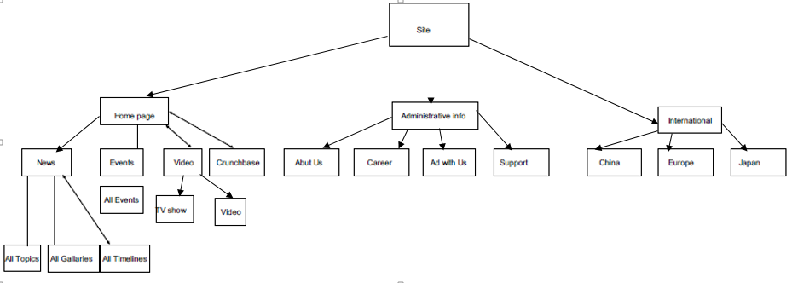
IA

